Slide 1
English To Urdu
Machine Translation
Abdul Moiz SHEHZAD (22L-7468)
Abdullah Riaz (22L-7489)

Slide 2
Model Introduction
Model Name: mBART50
Model Type: Sequence-to-sequence transformer
Why mBART50?
Pretrained on 50 languages (including Urdu)
Handles translation both to and from multiple languages
Outperformed other models (like BERT-based setups) in our tests

Slide 3
BART – Foundation of mBART
BART: Bidirectional and Auto-Regressive Transformers Architecture Type: Encoder–Decoder
Key Concepts:
Combines BERT (bidirectional encoder) and GPT (autoregressive decoder)
Pretraining using a denoising autoencoder objective
Input is corrupted (e.g., masking, shuffling)
Model learns to reconstruct original text

Slide 4
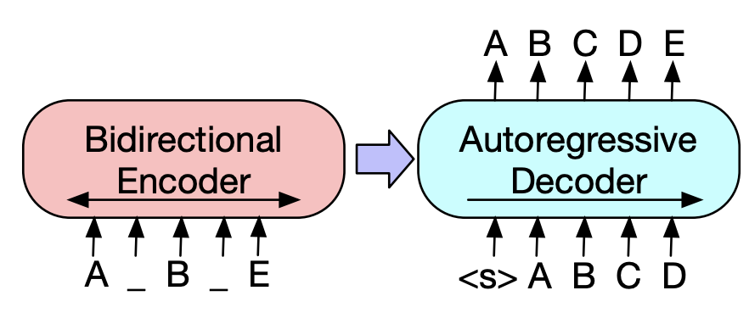
BART – Foundation of mBART (Cont.)
Architecture:
Similar to sequence-to-sequence Transformer (Attention is All You Need) except:
Encoder: 12 Transformer layers (bidirectional)
Decoder: 12 Transformer layers (left-to-right)

Slide 5
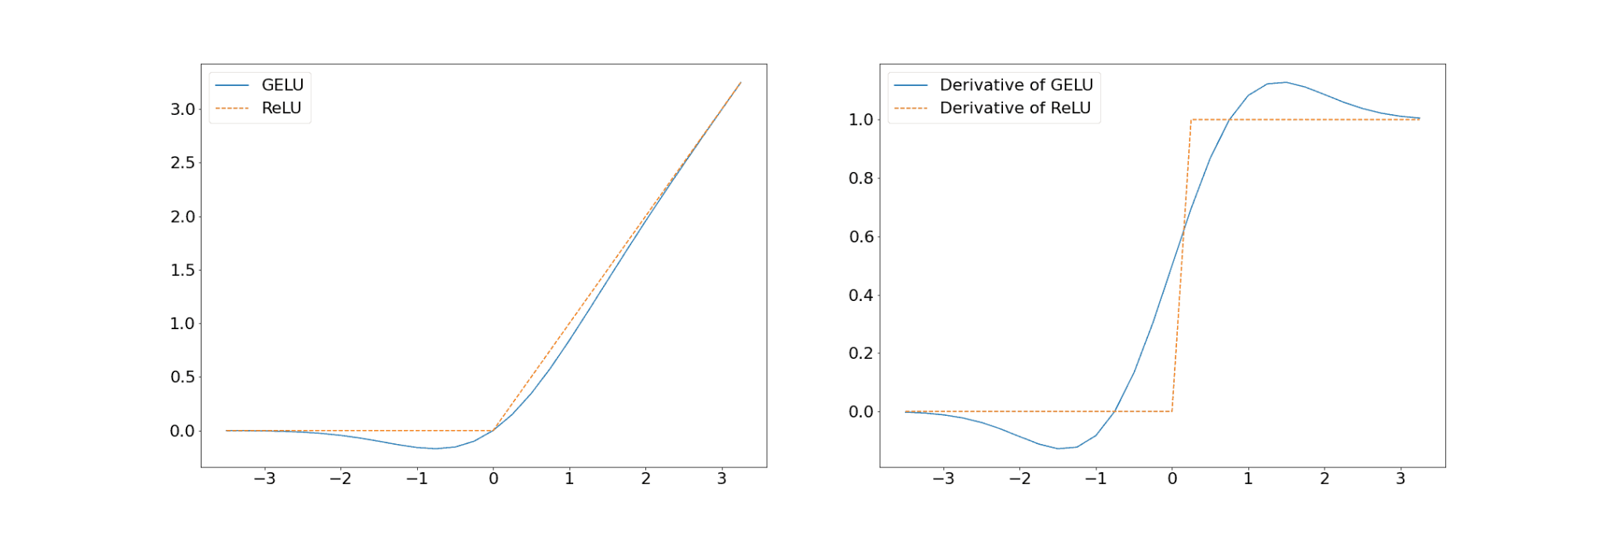
BART Architecture (Cont.)
Replace ReLU activation functions with GeLUs (Gaussian Error Linear Unit)
has a smooth, bell-shaped curve and provides non-zero gradients even for negative inputs

Slide 6
BART Architecture (Cont.)
Technical Details:
BART does not uses an additional feed-forward network before word prediction
BART contains roughly 10% more parameters than the equivalently sized BERT model.

Slide 7
What is mBART50?
mBART = Multilingual BART
mBART50 expands BART to 50 languages (both low- and high-resource)
Multilingual pretraining with language tokens for cross-lingual translation
e.g., <en_XX>, <ur_PK>

Slide 8
MBART50 (Cont.)
Component | Detail
Encoder Layers | 12 Transformer layers
Decoder Layers | 12 Transformer layers
Hidden Size | 1024 (internal vector size)
FFN Inner Size | 4096
Attention Heads | 16 per layer
Embedding Size | 1024
Max Positions | 1024
Vocabulary Size | ~250,000 (shared)
Parameters | ~610 million

Slide 9
Input Preparation and Tokenization
1. Input Format
<en_XX> The cat sat on the mat.
Language token tells the model input language
Output expected in <ur_PK> Urdu

Slide 10
Input Preparation and Tokenization (Cont.)
2. Tokenization
Uses SentencePiece tokenizer (subword-based)
Ensures even rare words or morphologically rich languages like Urdu can be handled
Example:
‘Internationalization is important’
"internationalization" → "inter", "national", "ization"

Slide 11
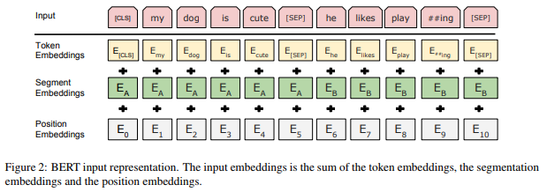
Input Preparation and Tokenization (Cont.)
3. Max Length Used
Fine-tuned with max sequence length = 128 tokens
4. Embedding and positional Encoding
Language Embedding

Slide 12
Pretraining Objective (Denoising Autoencoding)
Pretraining Task:
Corrupt the input (mask spans, permute tokens)
Train the model to reconstruct the original sentence
1. Text Infilling (MASKING spans)
Random spans of text are removed (not just individual tokens).
These are replaced with a single <mask> token.
"The quick brown fox jumps over the lazy dog"
→ "The <mask> jumps <mask> the dog"

Slide 13
Pretraining Objective (Cont.)
2. Sentence Permutation
For multi-sentence inputs, shuffle the order of entire sentences (helps with long-text understanding).
Example:
Input: [S1] I went home. [S2] I cooked dinner. [S3] Then I watched TV.
→ [S3] Then I watched TV. [S1] I went home. [S2] I cooked dinner.

Slide 14
Why not BERT + Decoder
Criteria | BERT | mBART50
Architecture | Encoder-only | Encoder-Decoder
Pretraining | MLM + NSP | Full sentence reconstruction
Translation-Ready | ❌ No decoding mechanism | ✅ Native translation model
Multilingual | ✅ Limited | ✅ 50 languages
Output Control | ❌ Needs custom decoding | ✅ Built-in autoregressive decoder
Conclusion:
BERT requires external decoder + embeddings
mBART50 is end-to-end and more efficient for translation

Slide 15
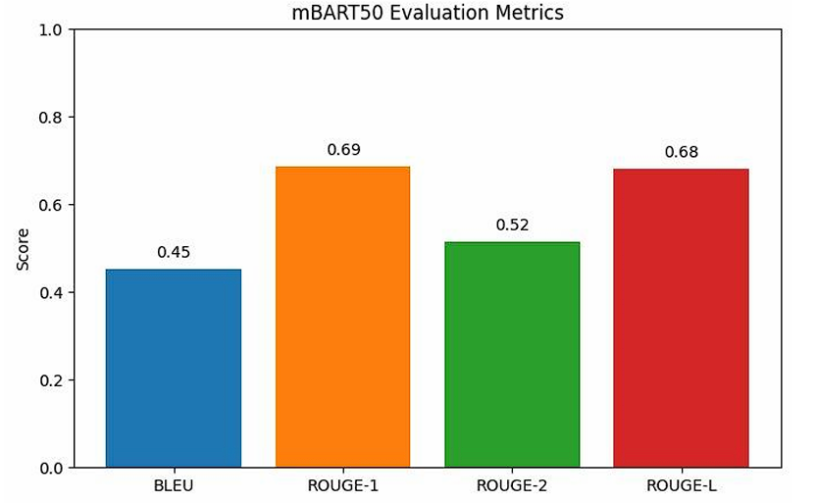
Results

Slide 16
Examples
English | Urdu (mBART50)
I love programming. | مجھے پروگرامنگ پسند ہے۔
Where are you going? | تم کہاں جا رہے ہو؟

Slide 17
Conclusion
mBART50 is a robust multilingual model
Supports English ↔ Urdu translation natively
Uses strong transformer architecture + denoising pretraining
Outperformed other tested models in both quality and BLEU score

Slide 18
References
mBART50 Research Paper Tang, Y., et al. (2020). Multilingual Translation with Extensible Multilingual Pretraining and Finetuning. https://arxiv.org/abs/2008.00401
BART: Denoising Sequence-to-Sequence Pre-training Lewis, M., et al. (2019). https://arxiv.org/abs/1910.13461 Hugging Face – mBART50 Model Card https://huggingface.co/facebook/mbart-large-50-many-to-many-mmt
SentencePiece Tokenizer Kudo, T. and Richardson, J. (2018). https://github.com/google/sentencepiece
BLEU Score Metric Papineni, K., et al. (2002). BLEU: a Method for Automatic Evaluation of Machine Translation. https://aclanthology.org/P02-1040.pdf

